Slide 1
Employee Data Analysis using Excel
STUDENT NAME: G . ARCHANA
REGISTER NO: 312216909
DEPARTMENT:BCOM GENERAL
COLLEGE:SHRI KRISHNASWANY COLLEGE FOR WOMEN

Slide 2
PROJECT TITLE
Salary & compensation Analysis through Excel Data Modelling

Slide 3


AGENDA
Problem Statement
Project Overview
End Users
Our Solution and Proposition
Dataset Description
Modelling Approach
Results and Discussion
Conclusion
3/21/2024 Annual Review

Slide 4

PROBLEM STATEMENT
The objective of the analysis: Understanding salary structures and compensation trends.Identifying disparities (e.g., by gender, department, or seniority).Why it's important to conduct this analysis (for decision-making, policy revision, etc.).

Slide 5

PROJECT OVERVIEW
.
Brief background on the importance of salary and compensation analysis.Objectives of the project (e.g., determine average salary, identify patterns in compensation, etc.).Key data analysis tools used (Excel, Pivot Tables, Charts, Slicers).

Slide 6

WHO ARE THE END USERS?
HR teams, finance departments, or organizational leadership.Decision-makers who need insights on salary distribution.How the analysis benefits these groups (e.g., improving salary policies, ensuring equity).

Slide 7

OUR SOLUTION AND ITS VALUE PROPOSITION
Overview of the solution provided through Excel data modelling.Key propositions:Creating clean, organized datasets for salary analysis.
Using pivot tables and slicers for dynamic analysis.
Visualizing trends with charts to enhance understanding.
How this solution adds value to the company’s salary structuring process

Slide 8
Dataset Description
Key features of the dataset:
Columns like employee ID, job title, department, salary, bonus, years of experience, etc.
Overview of data sources (HR systems, surveys, etc.).
Data cleaning: any missing values, outliers, or preprocessing done.

Slide 9
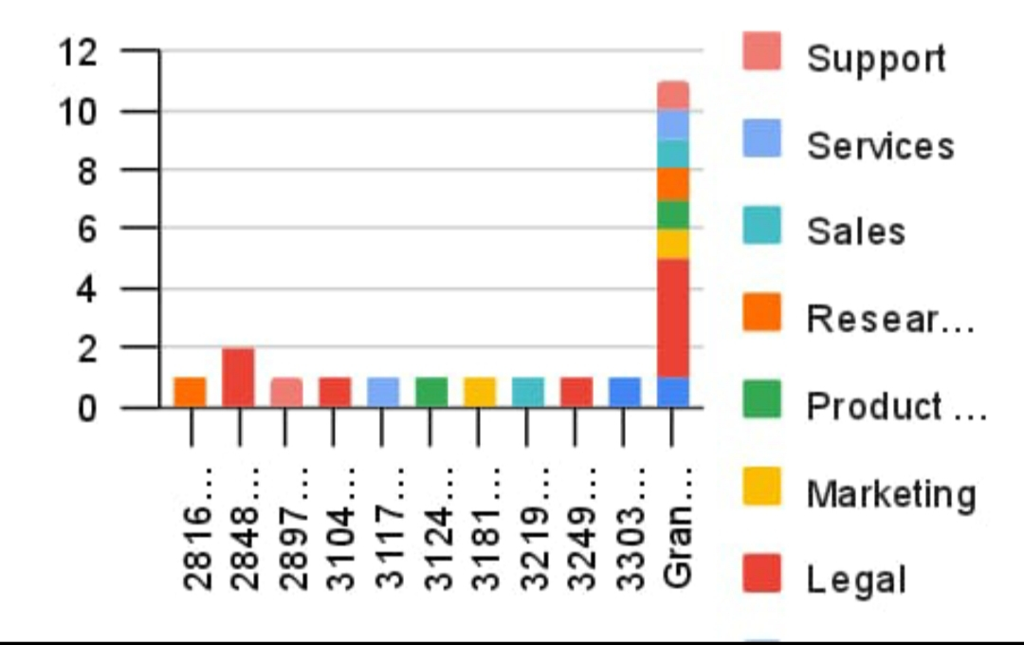

THE "WOW" IN OUR SOLUTION
3/21/2024 Annual Review
9

Slide 10
MODELLING
Step-by-step outline of how the data was analyzed:Cleaning and organizing data in Excel.
Creating Pivot Tables to summarize salary information.
Using Slicers to filter data dynamically (e.g., by department, gender).
Charting key trends for easy interpretation (e.g., bar charts, pie charts).
Techniques used for univariate and bivariate analysis.
10

Slide 11
RESULTS
Present key insights from the analysis:Average and median salary distribution.
Differences in salary based on department, gender, or years of experience.
Outliers or significant trends (e.g., high-paying departments).
Discussion on the relevance of these results to company policy or strategy.
11

Slide 12
conclusion
Recap key findings from the analysis.
Recommendations on how the company can use these insights to adjust salary structures or compensation packages.
Potential next steps for further analysis (e.g., adding more data points, cross-referencing with industry benchmarks).

